Slide 1
First Person Shooting Game
Abdur Rouf – 1505097
Shabuj Sarkar – 1505098
Aditya Larma - 1505120

Slide 2
Table of Content
Data Flow Diagram of Game Controller
Data Flow Diagram of Market Place
Sequence Diagram of Game Controller
Sequence Diagram of Market Place

Slide 3
Data Flow Diagram
Game Controller

Slide 4
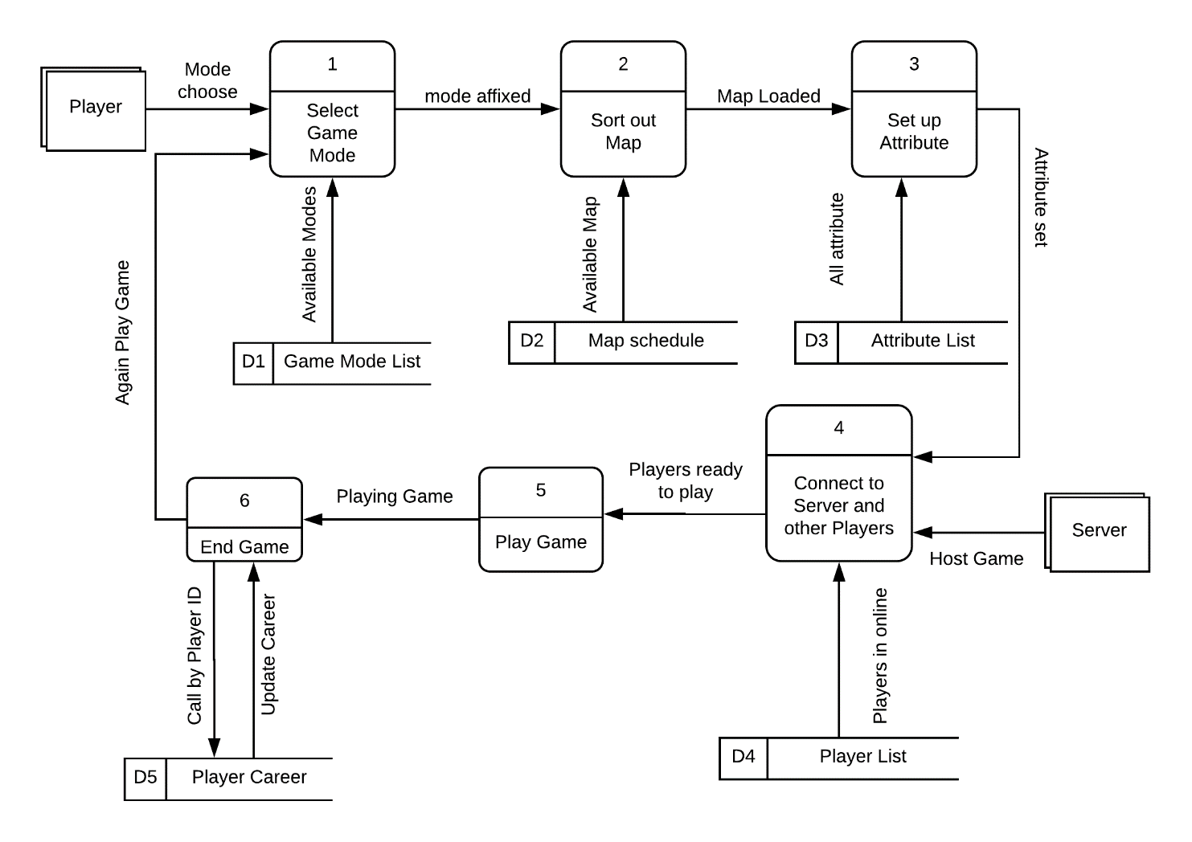

Slide 5
Data Flow Diagram
Market Place

Slide 6
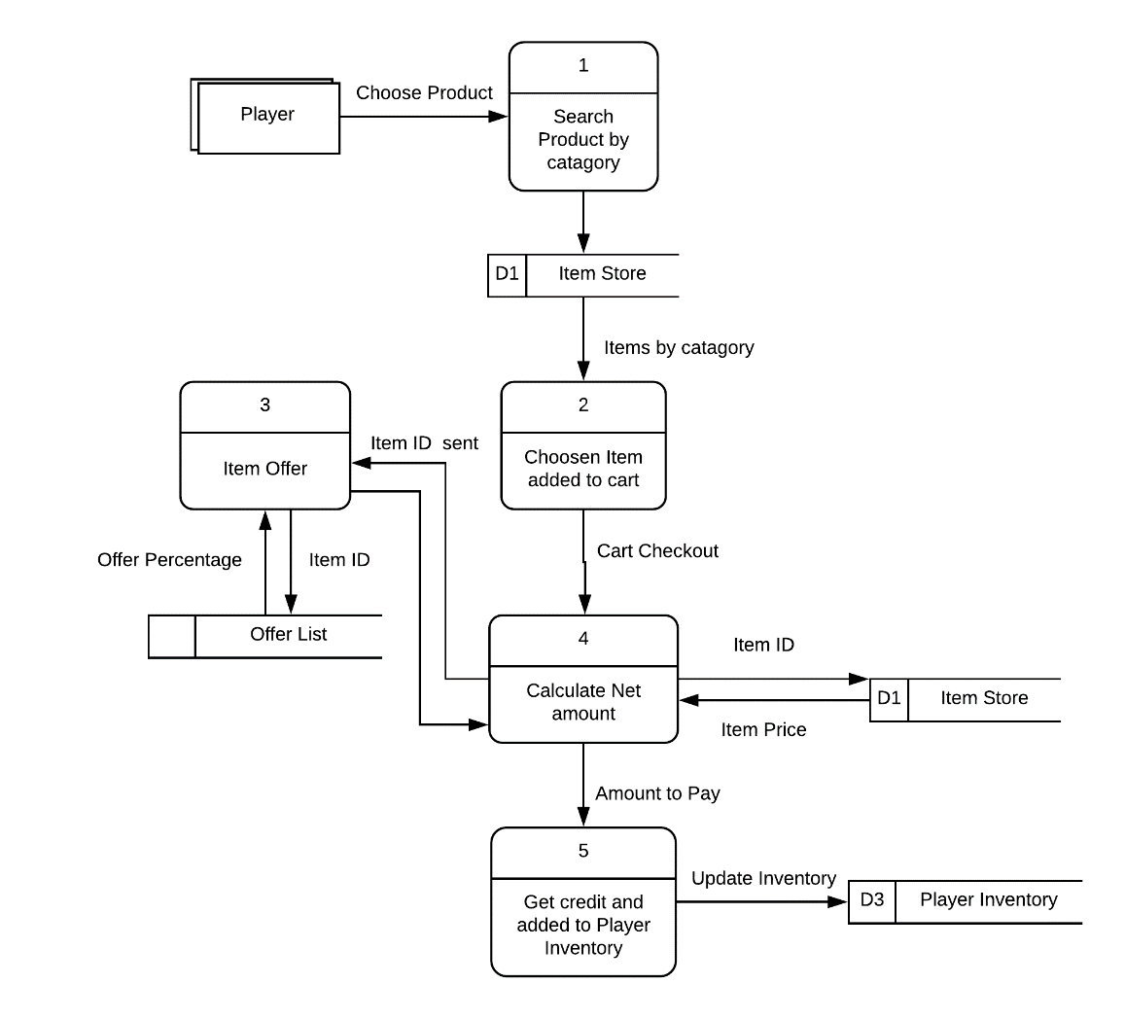

Slide 7
Sequence Diagram
Game Controller

Slide 8
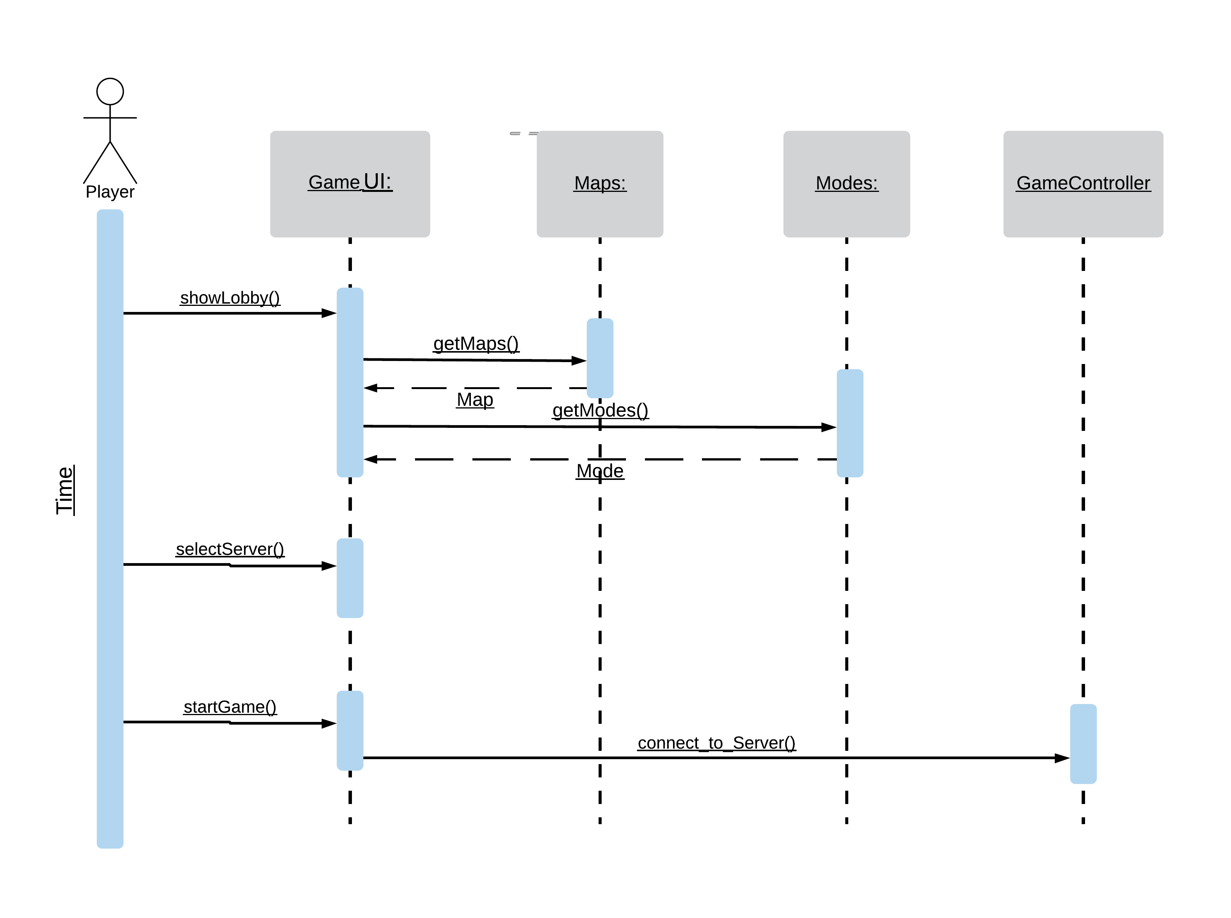

Slide 9
Sequence Diagram
Market Place

Slide 10
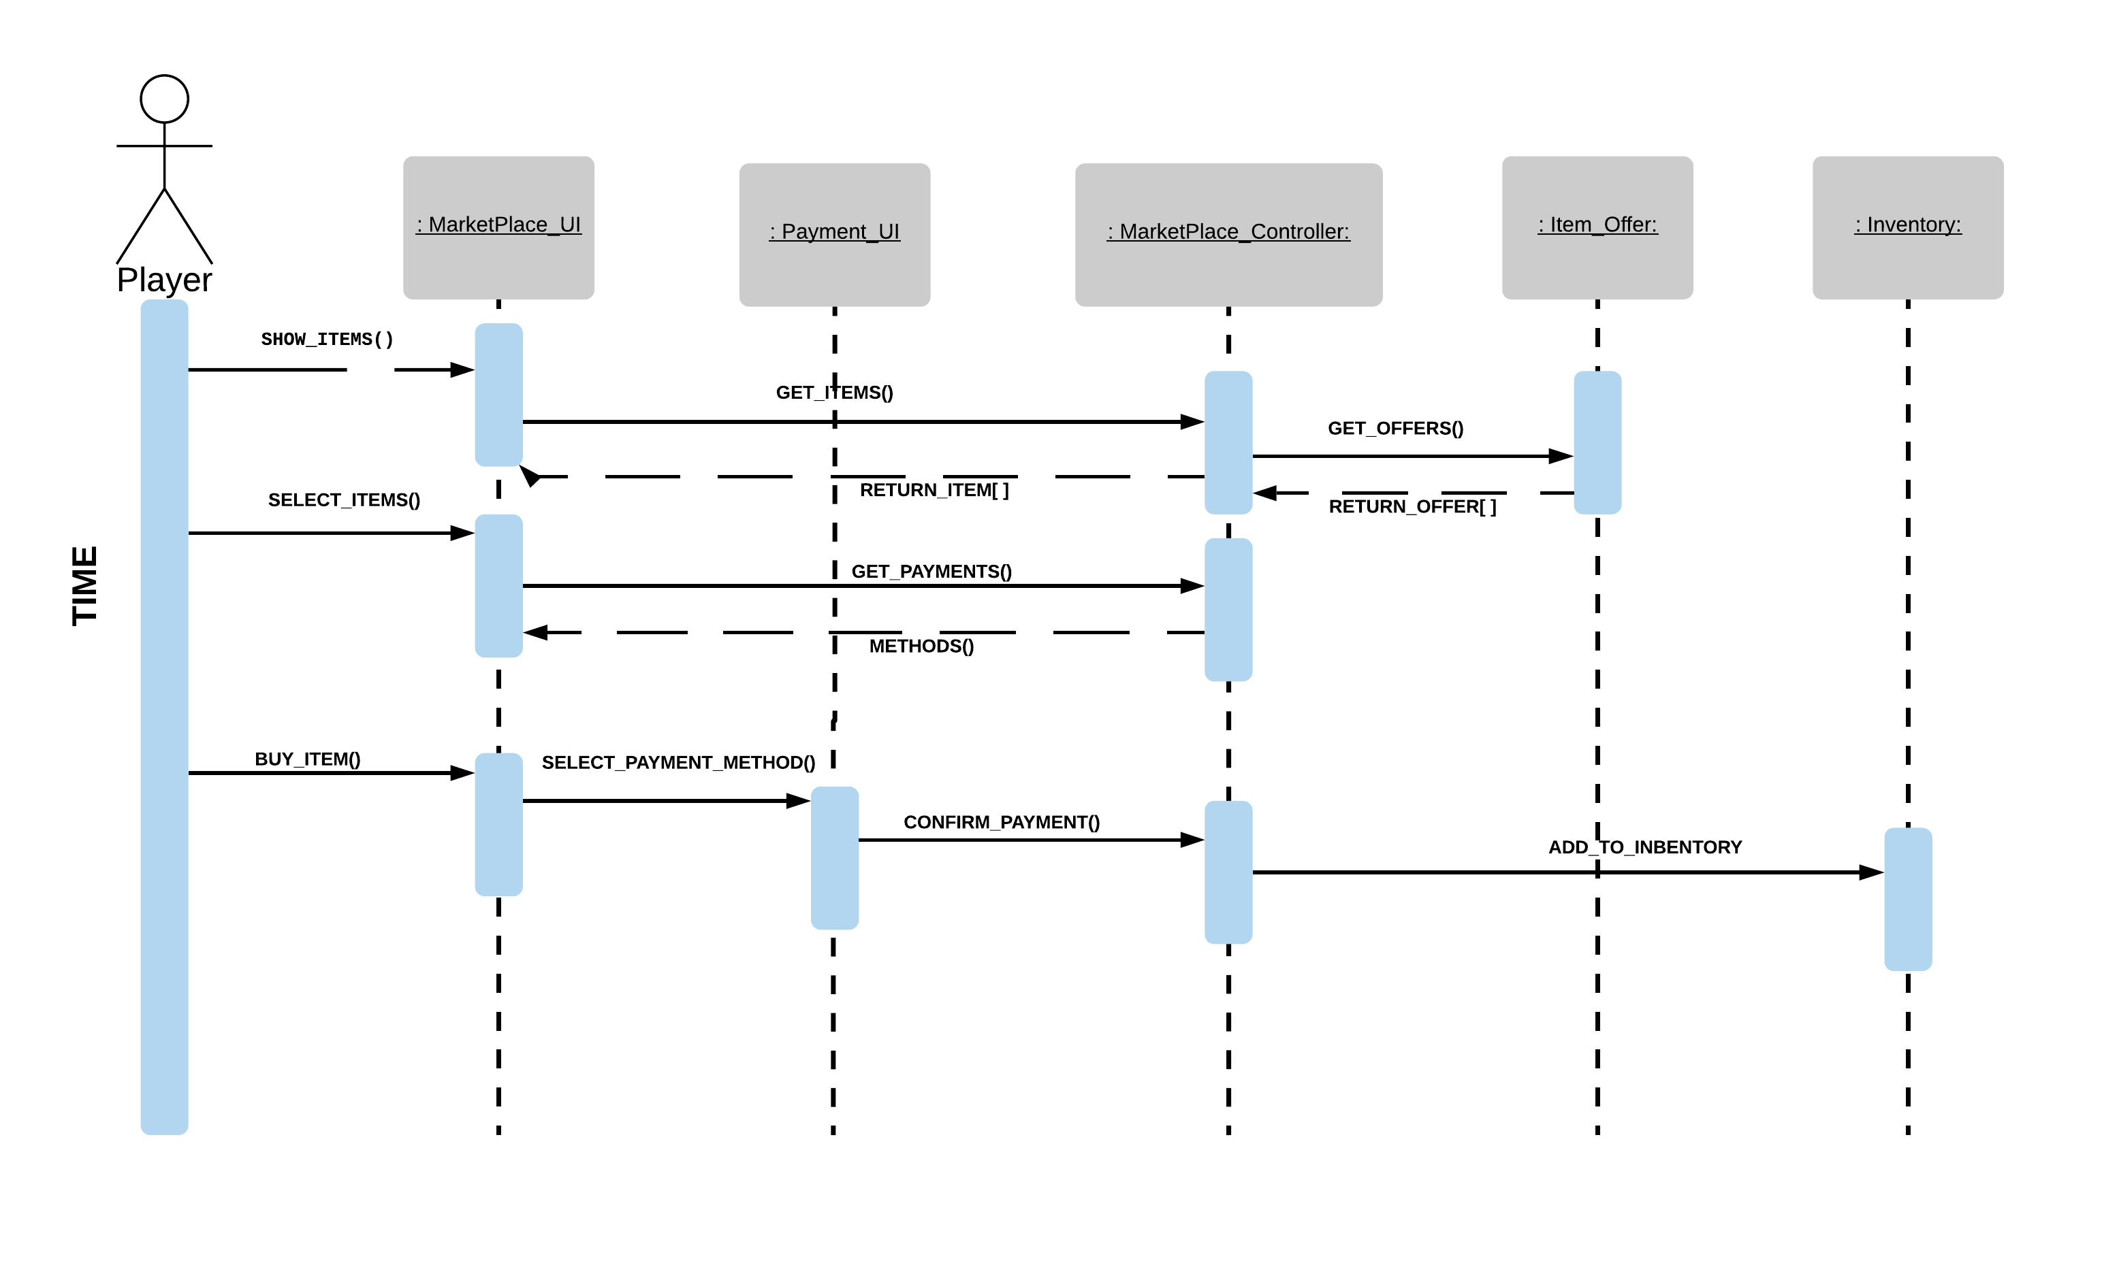

Slide 11
Thank You
☺

